Slide 1

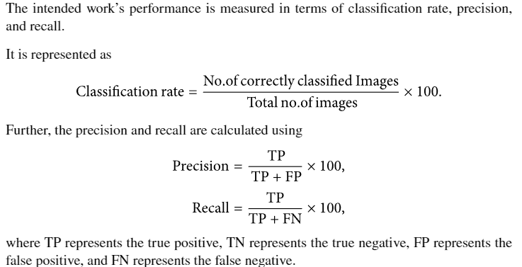
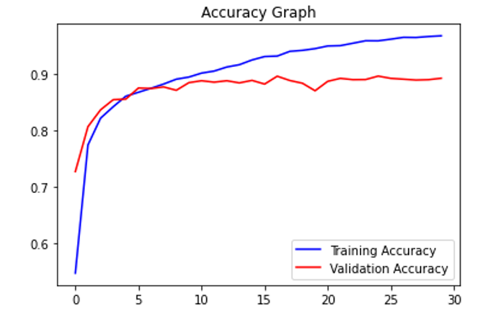
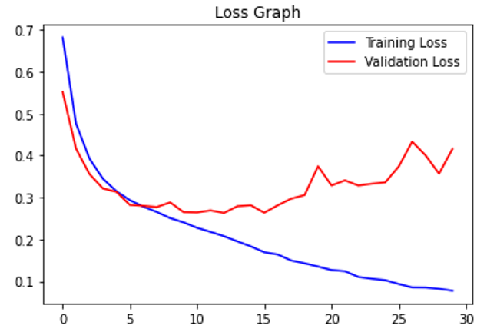
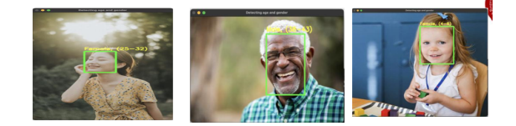
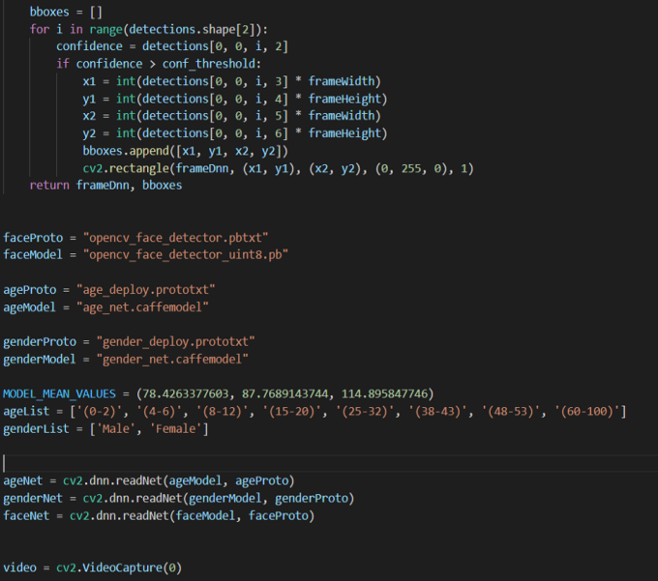
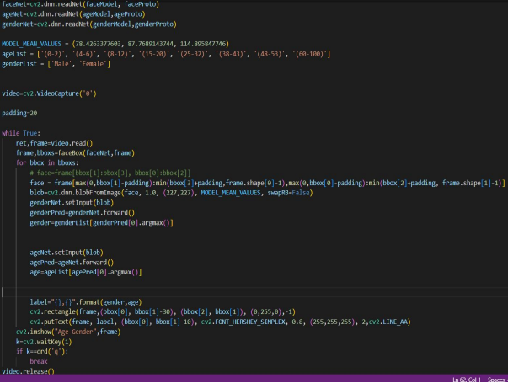
REAL-TIME AGE,GENDER PREDICTION AND CLASSIFICATION USING MACHINE LEARNING
Department of Computer Science & Engineering
School of Computing
1156CS701 – MAJOR PROJECT
WINTER SEMESTER 2022-2023
ABSTRACT
INTRODUCTION
RESULTS
STANDARDS AND POLICIES
The information of age is used in Government , Private and Advertising sector organization to find the culprits employee eligible for the job , audience to be targeted for their publicity of the product .
Age and Gender play fundamental role in social interactions, Language reserve different salutations and grammar rules for men or women, and very often different vocabularies are used when addressing elders compared to young people
The age estimation plays a prominent role in the applications like biometric evolution ,3d face making, Virtual makeup, and virtual try-on applications for jewelry and eye-ware by mapping the face according to the age found.
This model successfully executed with approximately 85% in Gender prediction and 75% in Age prediction that can be furtherly advanced with pipelining with other classification models and much larger real-world datasets.
We have implemented an efficient method in the detection of gender and age. With the minimum NN, the identification process was easy, less time taking to compute, and consumed less memory compared to other methologies in Machine Learning.
Agbo-Ajala O, Viriri S. Deeply Learned Classifiers for Age and Gender Predictions of Unfiltered Faces. ScientificWorldJournal. 2020 Apr 30; 2020:1289408. doi: 10.1155/2020/1289408. PMID: 32395084; PMCID: PMC7201854.
V. Carletti, A. S. Greco, G. Percannella, M. Vento, and I. Fellow, “Age from faces in the deep learning revolution,” IEEE Transactions on Pattern Analysis and Machine Intelligence, p. 1, 2019.
K. Zhang, C. Gao, L. Guo et al., “Age group and gender estimation in the wild with deep RoR architecture,” IEEE Access, vol. 5, pp. 22492– 22503, 2017.
Prediction of age and gender from face images has drawn a lot of attention recently,
due it is wide applications in various facial analysis problems. However, due to the large intra-class variation of face images (such as variation in lighting, pose, scale, occlusion), the existing models are still behind the desired accuracy level, which is necessary for the use of these models in real-world applications. In this work, we propose a deep learning framework, based
on the ensemble of attentional and residual convolutional networks, to predict gender and age group of facial images with high accuracy rate. Using attention mechanism enables our model to focus on the important and informative parts of the face, which can help it to make a more accurate prediction. We train our model in a multi-task learning fashion, and augment the feature embedding of the age classifier, with the predicted gender, and show that doing so can further increase the accuracy of age prediction. Our model is trained on a popular face age and gender dataset, and achieved promising results. Through visualization of the attention maps of the train model, we show that our model has learned to become sensitive to the right regions of the face.
Table 1. Plot the result.
METHODOLOGIES
Figure 1. Sample of input and output.
CONCLUSIONS
1.Data collection and Training 2 Processing of Data (UTKFace Dataset)
Using CNNs
We tackled the classification of age and gender of unfiltered real-world face images. We posed the task as a multi-class classification problem and, as such train the model with a classification-base loss function as training targets.
Our model successfully executed with approximately 85% in Ge5nder prediction and 75% in age prediction that can be furtherly advanced with pipelining with other classification models and much larger real-world datasets.
We have implemented an efficient method in the detection of gender and age. With the minimum NN, the identification process was easy, less time taking to compute, and consumed less memory compared to other methodologies in Machine Learning
TEAM MEMBER DETAILS
Shyam Kumar Sah
B.Chirumani Sai Pavan
+91 9031598415
+91 8688804576
vtu16200@veltech.edu.in
vtu12653@veltech.edu.in
ACKNOWLEDGEMENT
Dr. D Rajesh
+91 9688805797
drrajeshd@gmail.com
Chart 1. Bar Diagram

